Slide 1


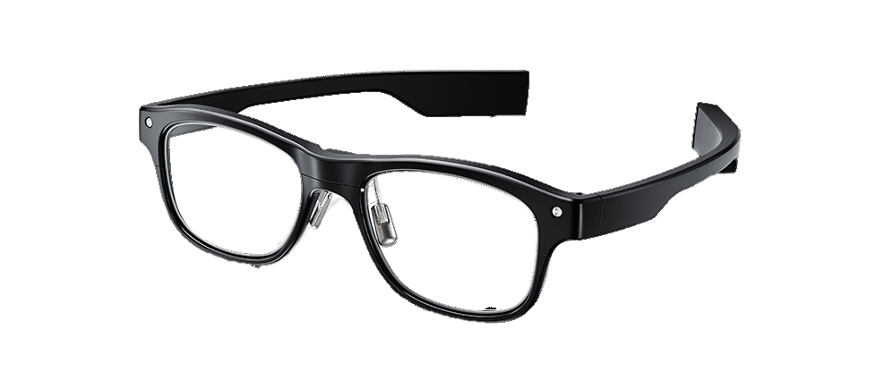
Interactive Analytics: Detecting Face Touch Events with Smartglasses
Huidi Zhu, Johan Krause, Sebastian Ebi, Calvin Antonius Tanama ● 7-23-2020

Slide 2
Table of contents
Motivation
Design of experiment
Data collecting
Data preprocessing
Model choosing and training
Results
Prototype demo

Slide 3
Motivation
From a study^{[1]}, students touch their face 23 times per hour on average
Face touching can cause transmission of various respiratory infection (COVID19 Coronavirus, Staphylococcus aureus)
With J!ns Meme Smartglasses and using deep learning want to build detection and warning system for face touching habit
[1] https://pubmed.ncbi.nlm.nih.gov/25637115/

Slide 4
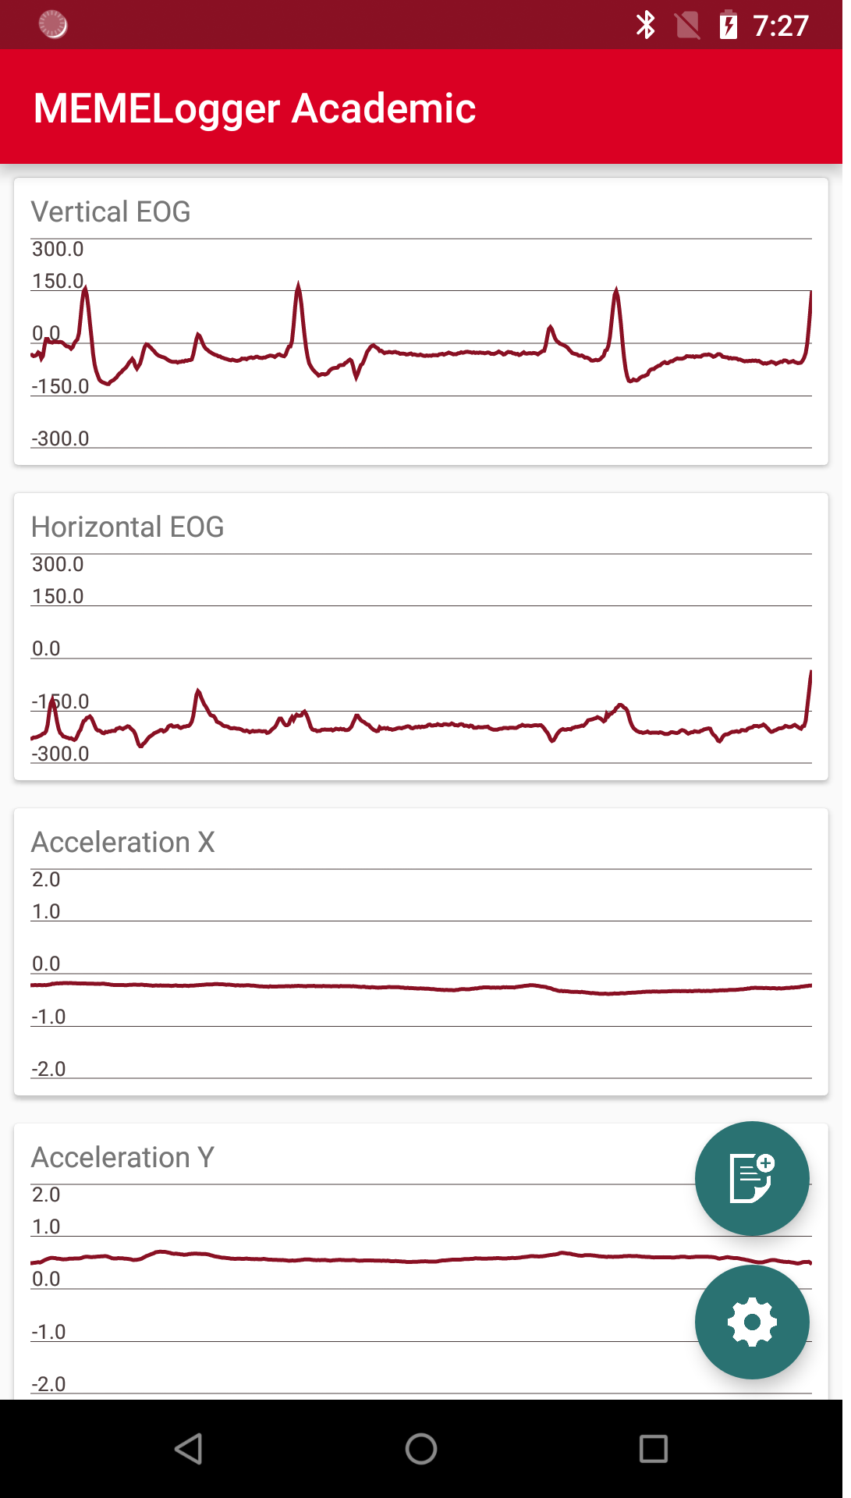
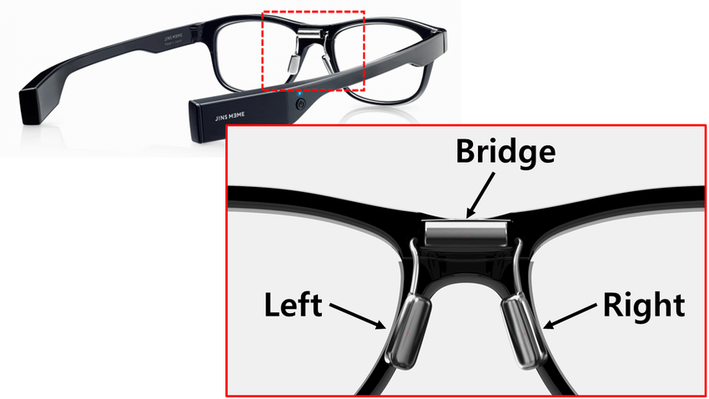
Device Specification
J!ns Meme Smartglasses have a three-point electrooculography sensor that connected to an android device via bluetooth
It measures whether there is a touch nearby the glasses

Slide 5
Design Of Experiment
Data Collecting
Data Preprocessing
Model Choosing and Training
Model Evaluation

Slide 6
Design Of Experiment
Data Collecting
Data Preprocessing
Model Choosing and Training
Model Evaluation

Slide 7
Data Collecting: Natural Data
Goal: To be the test data for our system in the real situation
Modality: Respondents are required to wear the J!ns Meme device while doing activity and record the impulses of touches for 60 minutes

Slide 8
Data Collecting: Sampling Data
Goal: To be the training data for our system
Modality: Fix 4 touch classes (mouth, nose, left eye, right eye) and let the respondents touch these classes while being prompted.
For this experiment, we create a protocol application that would prompt respondents to touch the classes. The sequence of the events are generated randomly

Slide 9
Data Collecting: Labeling
To label the data, we use Anvil^{[2]}. This application annotate videos taken from respondents and convert it into label.
Although the starting point of video recording and J!ns Meme recording are not same, we agree to add starting and ending synchronization by touching the nose 3 times

Slide 10
Design Of Experiment
Data Collecting
Data Preprocessing
Model Choosing and Training
Model Evaluation

Slide 11
Data Preprocessing
Goal: Upscaling the annotation from Anvil
The video is recorded at 30 FPS rate but the J!ns Meme recording is at 50 Hz rate.
After we annotate the video with Anvil, we span the annotation to 50 Hz rate and cut the synchronization mark

Slide 12
Design Of Experiment
Data Collecting
Data Preprocessing
Model Choosing and Training
Model Evaluation

Slide 13
Model Choosing: Decision
We are dealing with time series data (touches in the protocol takes places randomly)
The model of recurrent neuronal network (RNN) and its derivative (for example LSTM) would be suitable for this problem, because of its capability to process data with variable length

Slide 14
Model Choosing: RNN
Hier ergänzen

Slide 15
Model Choosing: LSTM
Hier ergänzen

Slide 16
Long Short Term Memory (LSTM)
tries to solve the vanishing gradient problem
no bias towards the latest observations is appended
accurate modeling of short- and long-term dependencies in Time Series
Key concept:
Introduction of a Cell State
fine-grained control over the data written into memory
so-called “Gates" are used for this purpose
Hochreiter, Sepp; Schmidhuber, Jürgen (1997): Long Short-Term Memory. In: NeuralComputation9 (8),p. 1735–1780
Bianchi, Filippo Maria; Maiorino, Enrico; Kampffmeyer, Michael C.; Rizzi, Antonello;
Jenssen, Robert (2017): Recurrentneuralnetworksforshort-term loadforecasting. An overviewand comparativeanalysis. Cham: Springer (SpringerBriefsin Computer Science),p. 25-27

Slide 17
Long Short Term Memory (LSTM)
based on:
Bianchi, Filippo Maria; Maiorino, Enrico; Kampffmeyer, Michael C.; Rizzi, Antonello; Jenssen, Robert
(2017): Recurrent neural networks for short-term load forecasting. An overview and comparative analysis.
Cham: Springer (SpringerBriefs in Computer Science),
p. 27, figure 3.1

Slide 18
Long Short Term Memory (LSTM)
Cell State:
Horizontal line in the upper are of the LSTM cell
only minor linear interactions
LSTM-Net has the ability to remove information from the cell state and to append new information
→Regulation through so-called "Gates“
Hochreiter, Sepp; Schmidhuber, Jürgen (1997): Long Short-Term Memory. In: Neural Computation 9 (8),
p. 1735–1780
Bianchi, Filippo Maria; Maiorino, Enrico; Kampffmeyer, Michael C.; Rizzi, Antonello; Jenssen, Robert (2017): Recurrent neural networks for short-term load forecasting. An overview and comparative analysis.
Cham: Springer (SpringerBriefs in Computer Science), p. 25-27

Slide 19
Long Short Term Memory (LSTM)
LSTM cell has several gates:
Forget Gate
Input Gate
Output Gate
Gate-Structure
Hochreiter, Sepp; Schmidhuber, Jürgen (1997): Long Short-Term Memory. In: Neural Computation 9 (8),
p. 1735–1780
Bianchi, Filippo Maria; Maiorino, Enrico; Kampffmeyer, Michael C.; Rizzi, Antonello; Jenssen, Robert (2017): Recurrent neural networks for short-term load forecasting. An overview and comparative analysis.
Cham: Springer (SpringerBriefs in Computer Science), p. 25-27

Slide 20
Long Short Term Memory (LSTM)
Forget Gate:
What information should be discarded from the Cell State?
Decision is made using the sigmoid function:
0 = remove information completely
1 = retain information completely
a number between 0 and 1 is calculated for each entry in the cell state C(t-1)
Hochreiter, Sepp; Schmidhuber, Jürgen (1997): Long Short-Term Memory. In: Neural Computation 9 (8),
p. 1735–1780
Bianchi, Filippo Maria; Maiorino, Enrico; Kampffmeyer, Michael C.; Rizzi, Antonello; Jenssen, Robert (2017): Recurrent neural networks for short-term load forecasting. An overview and comparative analysis.
Cham: Springer (SpringerBriefs in Computer Science), p. 25-27

Slide 21
Long Short Term Memory (LSTM)
Input Gate:
Which new information should be transferred to the Cell State and how?
first it is decided which values are to be updated in the cell state
then a candidate vector Z(t) is generated using the tanh function, which could be included in the cell state
Hochreiter, Sepp; Schmidhuber, Jürgen (1997): Long Short-Term Memory. In: Neural Computation 9 (8),
p. 1735–1780
Bianchi, Filippo Maria; Maiorino, Enrico; Kampffmeyer, Michael C.; Rizzi, Antonello; Jenssen, Robert (2017): Recurrent neural networks for short-term load forecasting. An overview and comparative analysis.
Cham: Springer (SpringerBriefs in Computer Science), p. 25-27

Slide 22
Long Short Term Memory (LSTM)
Cell State Update:
The cell state is updated as follows C(t) = f(t) * C(t-1) + i(t) * Z(t)
Hochreiter, Sepp; Schmidhuber, Jürgen (1997): Long Short-Term Memory. In: Neural Computation 9 (8),
p. 1735–1780
Bianchi, Filippo Maria; Maiorino, Enrico; Kampffmeyer, Michael C.; Rizzi, Antonello; Jenssen, Robert (2017): Recurrent neural networks for short-term load forecasting. An overview and comparative analysis.
Cham: Springer (SpringerBriefs in Computer Science), p. 25-27

Slide 23
Long Short Term Memory (LSTM)
Output Gate:
What is the output of the LSTM cell?
The output is based on the cell state, but is filtered
by means of the sigmoid function the parts of C(t) are determined, which should belong to the output
Output
By means of tanh the cell state is normalized to [-1, 1] and then with the filtered cell state from multiplied by the output gate
Bianchi, Filippo Maria; Maiorino, Enrico; Kampffmeyer, Michael C.; Rizzi, Antonello; Jenssen, Robert (2017): Recurrent neural networks for short-term load forecasting. An overview and comparative analysis.
Cham: Springer (SpringerBriefs in Computer Science), p. 25-27

Slide 24
Long Short Term Memory (LSTM)
Based on:
Bianchi, Filippo Maria; Maiorino, Enrico; Kampffmeyer, Michael C.; Rizzi, Antonello; Jenssen, Robert (2017): Recurrent neural networks for short-term load forecasting. An overview and comparative analysis.
Cham: Springer (SpringerBriefs in Computer Science), p. 27, figure 3.1

Slide 25
Design Of Experiment
Data Collecting
Data Preprocessing
Model Choosing and Training
Model Evaluation

